Slide 1

Photosynthetic Adaptations of Polar Phytoplankton to Extreme Low Light
Natasha Madeleine Ryan
Supervised By Dr. Douglas A. Campbell

Slide 2
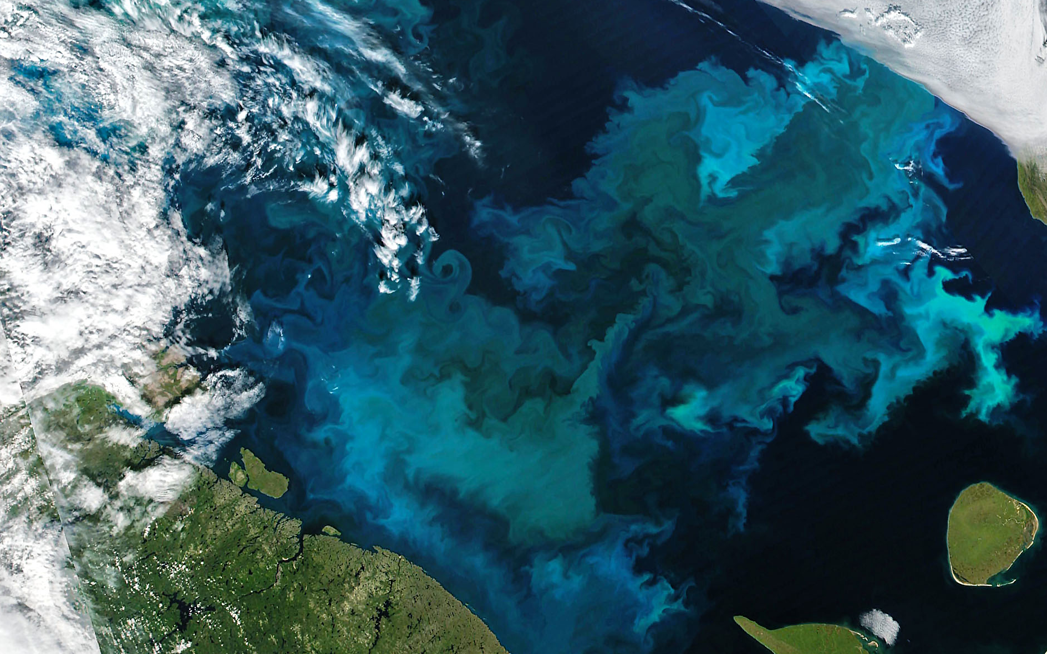
Spring Phytoplankton Blooms
Ardyna & Arrigo, 2020. Nature Climate Change Phytoplankton Bloom in the Barents Sea, Joshua Stevens, NASA

Slide 3
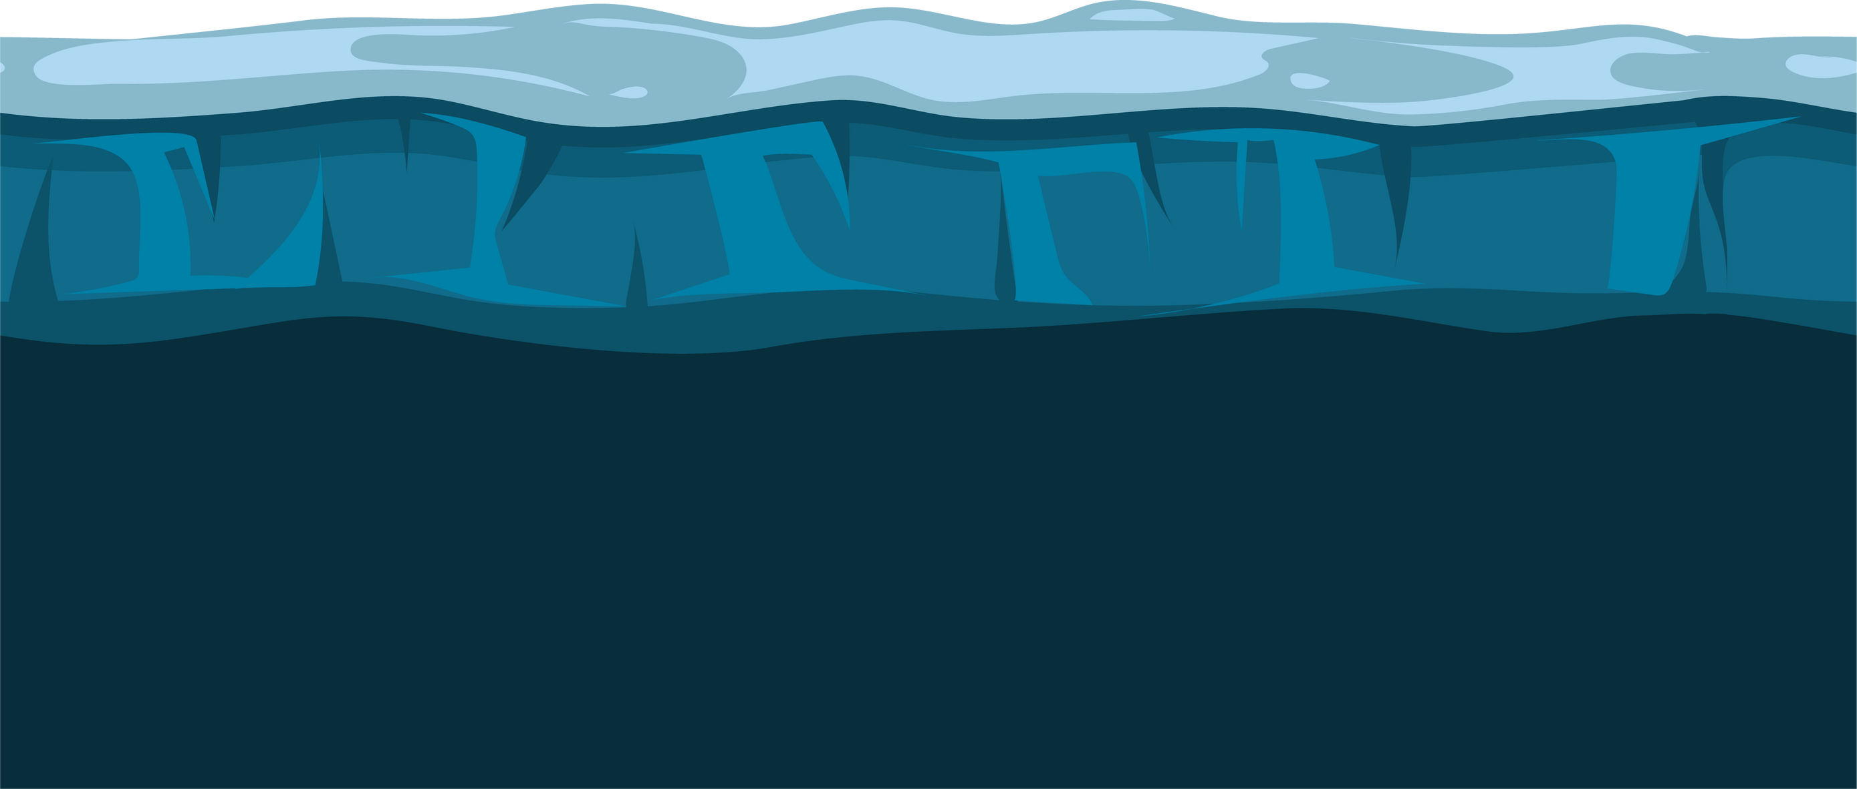
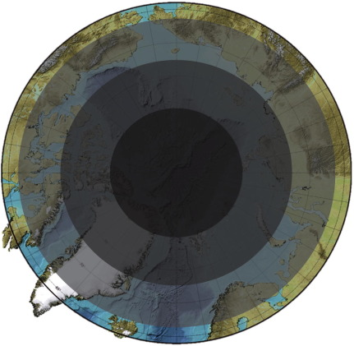
Photic Constraints
Light Attenuation
Polar Night
z
L
I
G
H
T
Randelhoff et al, 2020. Science Advances Hancke et al, 2018. J Geophysical Research Raven et al, 2000. J Marine Biological Association Map: Berge et al, 2015. Progress in Oceanography

Slide 4
Have polar phytoplankton adapted to extremely low light by increasing their efficiency of photosynthetic energy conversion?

Slide 5
Have polar phytoplankton adapted to extremely low light by increasing their efficiency of photosynthetic energy conversion?
Hypothesized Mechanism: suppressing energetically wasteful charge recombinations in Photosystem II

Slide 6
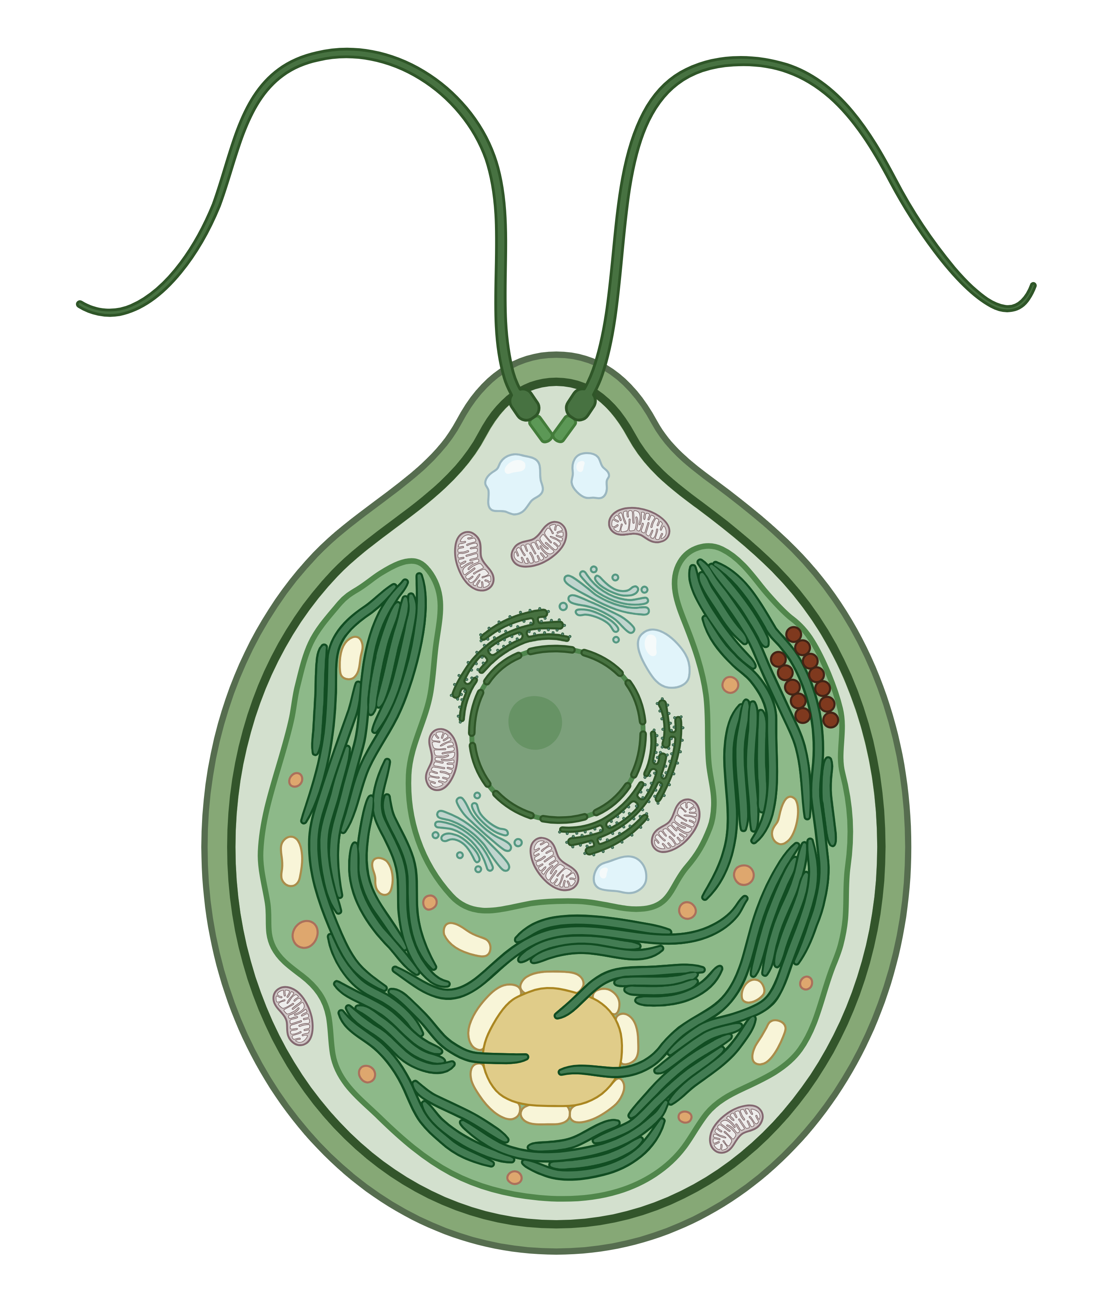
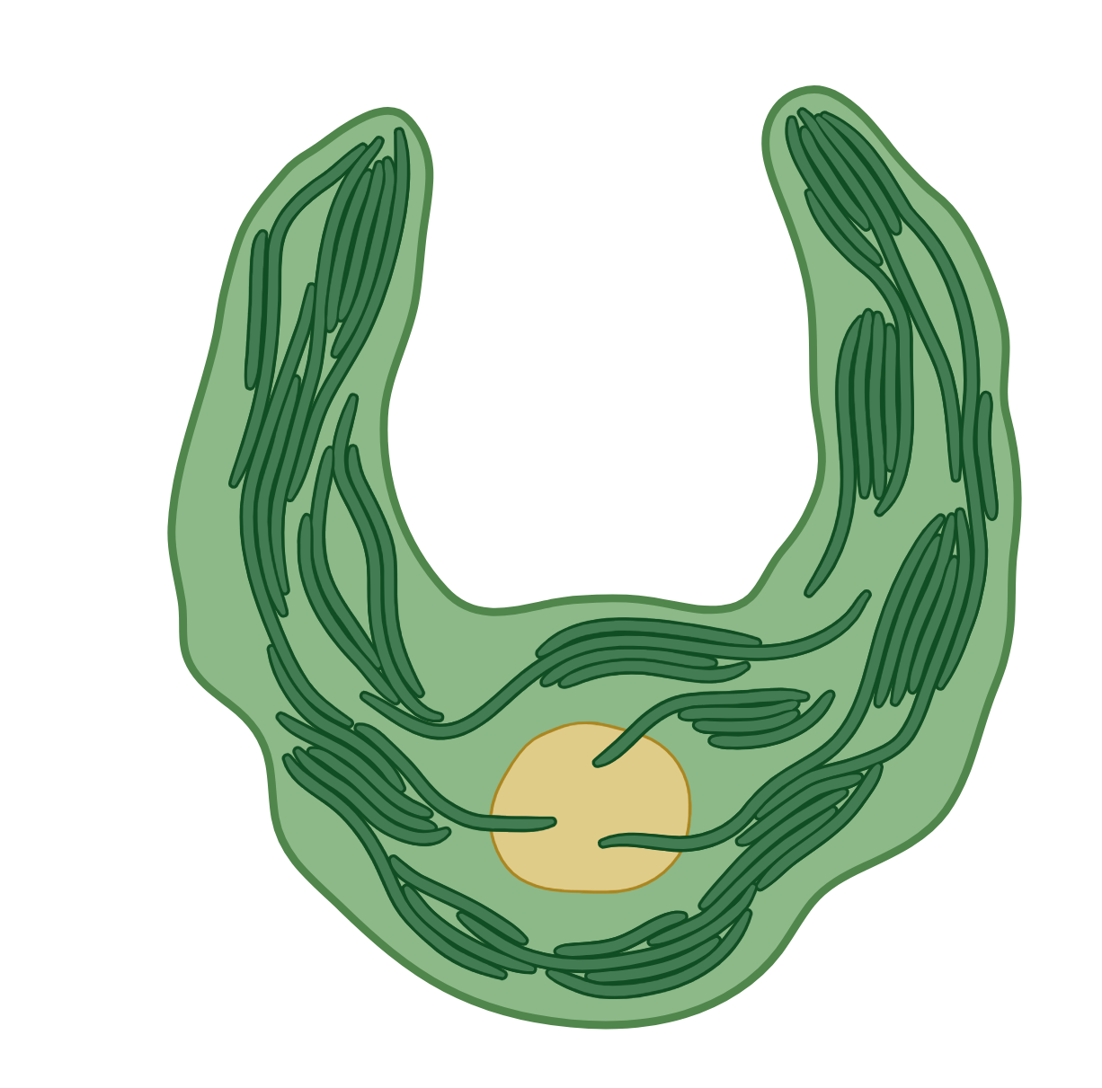
Phytoplankton Cell
Kirk, 2011. Cambridge University Press Image: BioRender

Slide 7
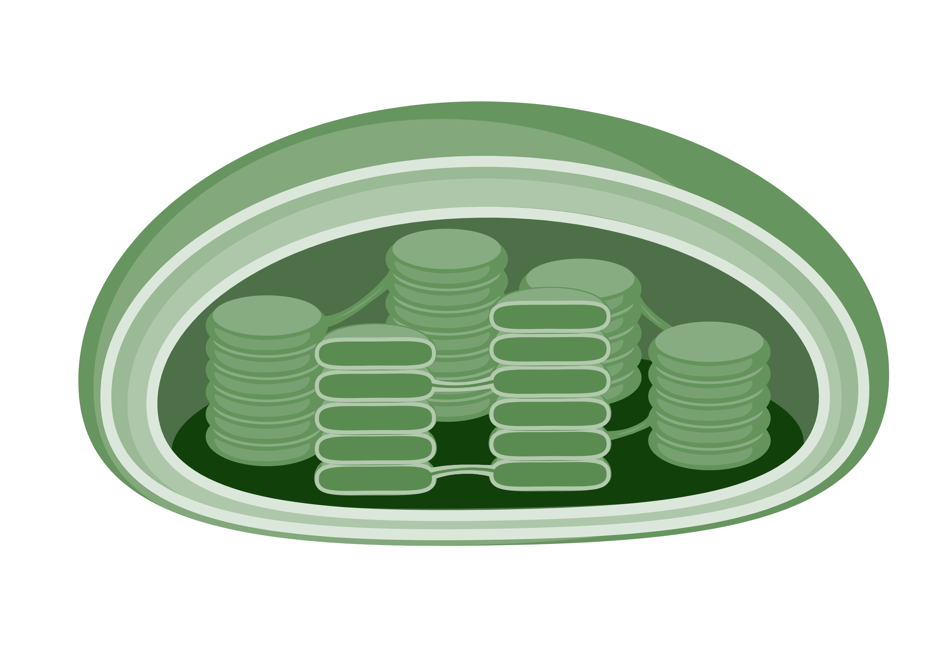
Chloroplast & Thylakoids
Kirk, 2011. Cambridge University Press Image: BioRender

Slide 8
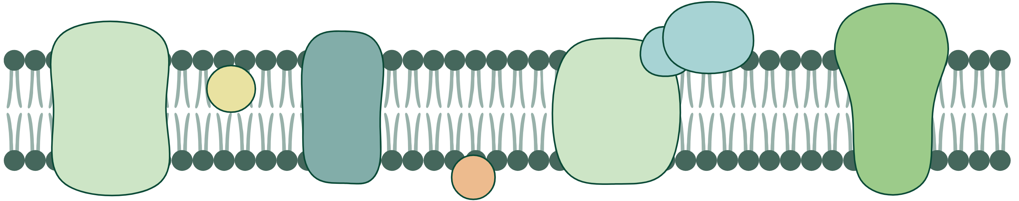
PSII
ATP
Synthase
Cyt b₆f
PSI
PQ
PC
Thylakoid Membrane
Kawakami & Shen, 2018. Methods in Enzymology Image: BioRender

Slide 9
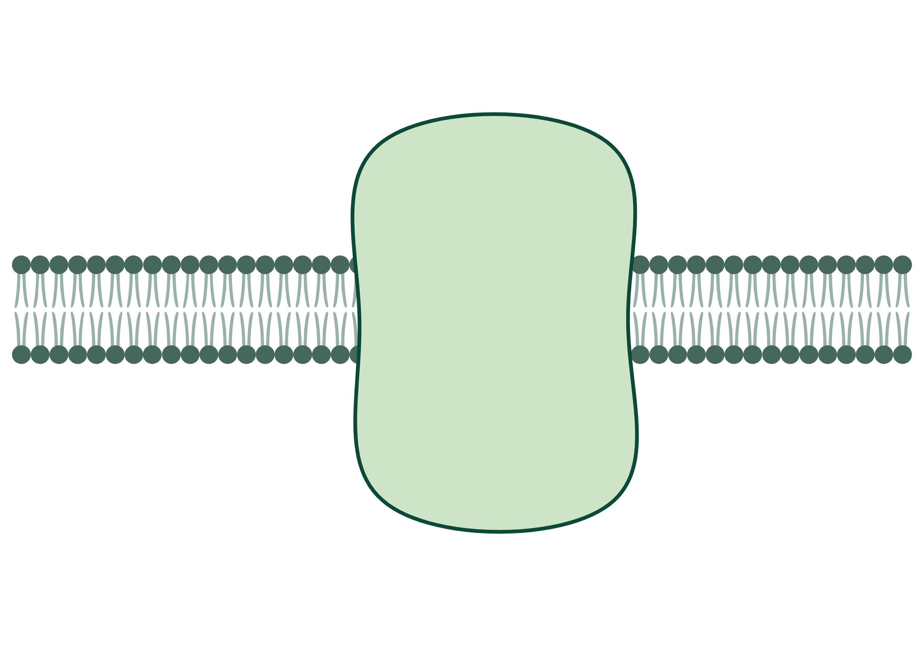
NADP⁺
NADPH
RCII
Phe
ATP
Synthase
Cyt b₆f
PSI
PQ
Q_{A}
Q_{B}
PC
RCII
Photosystem II
Gates et al, 2020. Biochimica et Biophysica Acta Mukhopadhyay et al, 2004. Chemical Reviews

Slide 10
NADP⁺
NADPH
RCII
Phe
ATP
Synthase
Cyt b₆f
PSI
PQ
Q_{A}
Q_{B}
PC
RCII
e⁻
Mn₄CaO₅
Photosystem II
Gates et al, 2020. Biochimica et Biophysica Acta Mukhopadhyay et al, 2004. Chemical Reviews

Slide 11
NADP⁺
NADPH
RCII
Phe
ATP
Synthase
Cyt b₆f
PSI
PQ
Q_{A}
Q_{B}
PC
RCII
e⁻
e⁻
Mn₄CaO₅
e⁻
e⁻
2H₂O
4H⁺ + O₂
Photosystem II
Gates et al, 2020. Biochimica et Biophysica Acta Mukhopadhyay et al, 2004. Chemical Reviews

Slide 12
Stable Cycling
NADP⁺
NADPH
ADP
ATP
e⁻
e⁻
e⁻
e⁻
e⁻
e⁻
e⁻
e⁻
e⁻
e⁻
e⁻
Mn₄CaO₅
e⁻
e⁻
2H₂O
4H⁺ + O₂
Keren et al, 1997. Proceedings of the National Academy of Sciences Rappaport et al, 2005. Biophysical Journal

Slide 13
St-ChlF Approach
e⁻
e⁻
Mn₄CaO₅
e⁻
e⁻
1
4
2
3
Gates et al, 2020. Biochimica et Biophysica Acta Zaharieva & Dau, 2019. Frontiers in Plant Science Schuback et al, 2021. Frontiers in Marine Science

Slide 14
High Light
Low Light
Shorter spacing between flashes
Longer spacing between flashes
Berman-Frank et al, 2023. Scientific Committee on Oceanic Research

Slide 15
Recombination
RCII
Phe
Q_{A}
e⁻
Q_{B}
e⁻
RCII
Vass, 2011. Physiologia Plantarum Rappaport et al, 2005. Biophysical Journal

Slide 16
Idealized PSII Population
PSII Population with Recombination
e⁻
e⁻
e⁻
e⁻
e⁻
e⁻
e⁻
e⁻
e⁻
e⁻
Mn₄CaO₅
Mn₄CaO₅
e⁻
e⁻
e⁻
e⁻
e⁻
e⁻
e⁻
e⁻
e⁻
e⁻
Synchronized Cycling
Desynchronized Cycling
Periodic ChlF Oscillations
Damped ChlF Oscillations
de Wijn & van Gorkom, 2002. Photosynthesis Research

Slide 17
Wavelet Transformation
Sample Plots: Fragilariopsis cylindrus at 0°C and 0.6 µmol photons m⁻²s⁻¹
Raw Fluorescence Data
Fourier Wavelets
Roesch & Schmidbauer, 2018. WaveletComp Theis & Meyer-Bäse, 2010. Biomedical Signal Analysis

Slide 18
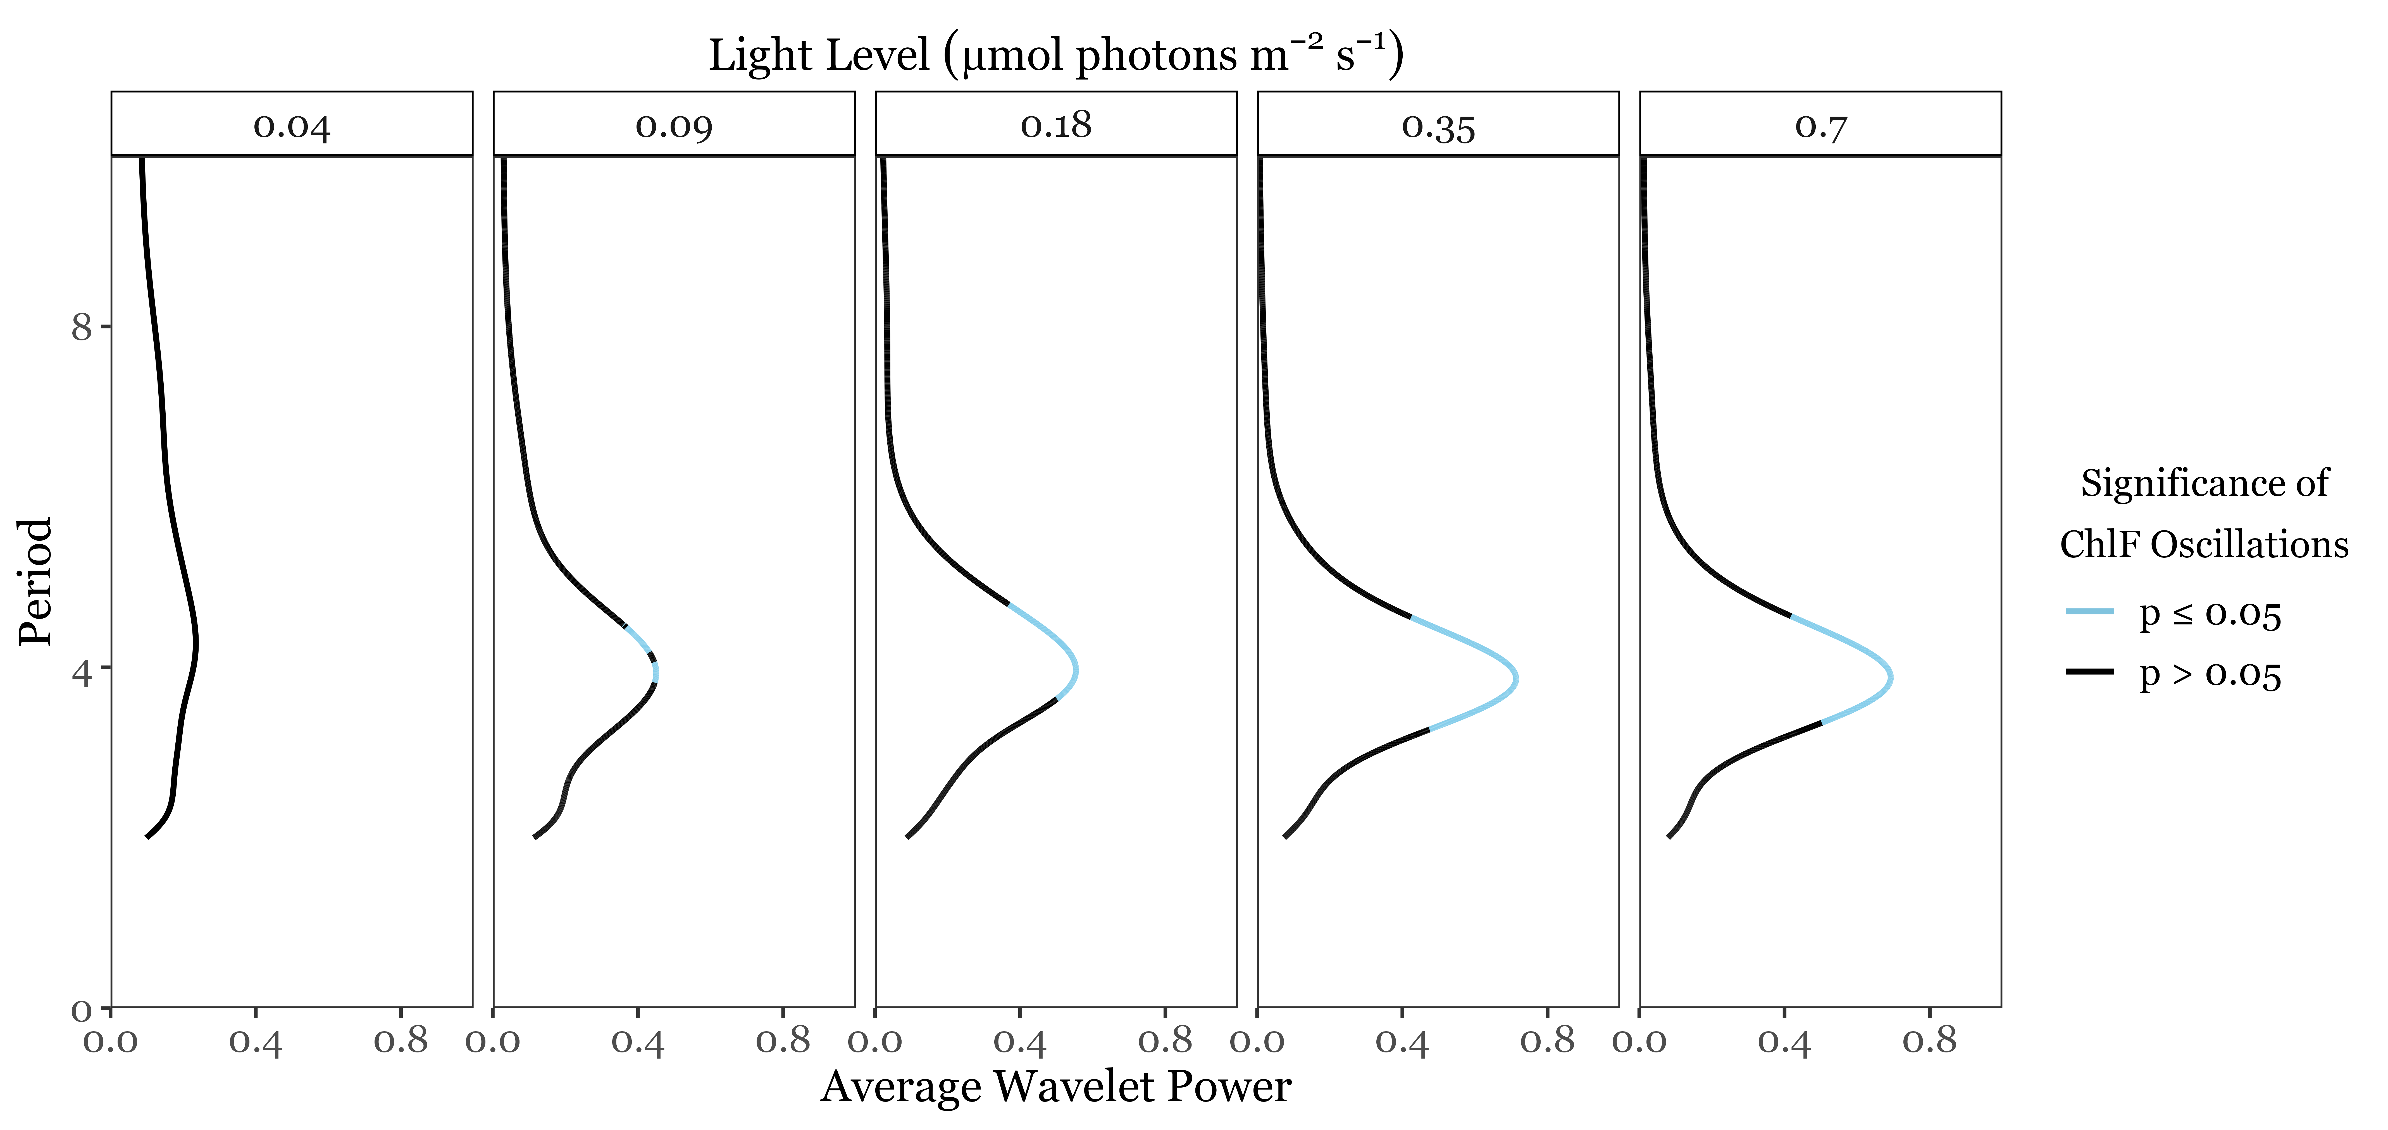
ChlF Periodicity
Sample Plot: Chlamydomonas priscuii at 8°C

Slide 19
Duration of Cycling
Sample Plot: Chlamydomonas priscuii at 8°C & 0.7 µmol photons m⁻²s⁻¹
Loss of synchronization due to energetically wasteful recombinations

Slide 20
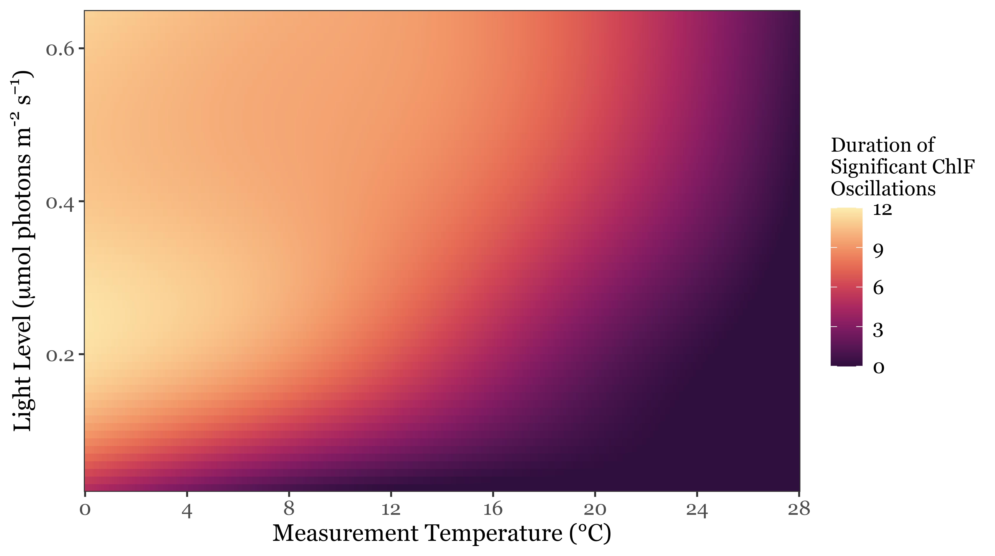
Individual strains sustain ChlF oscillations longer under measurement at higher light levels & lower temperatures

Slide 21
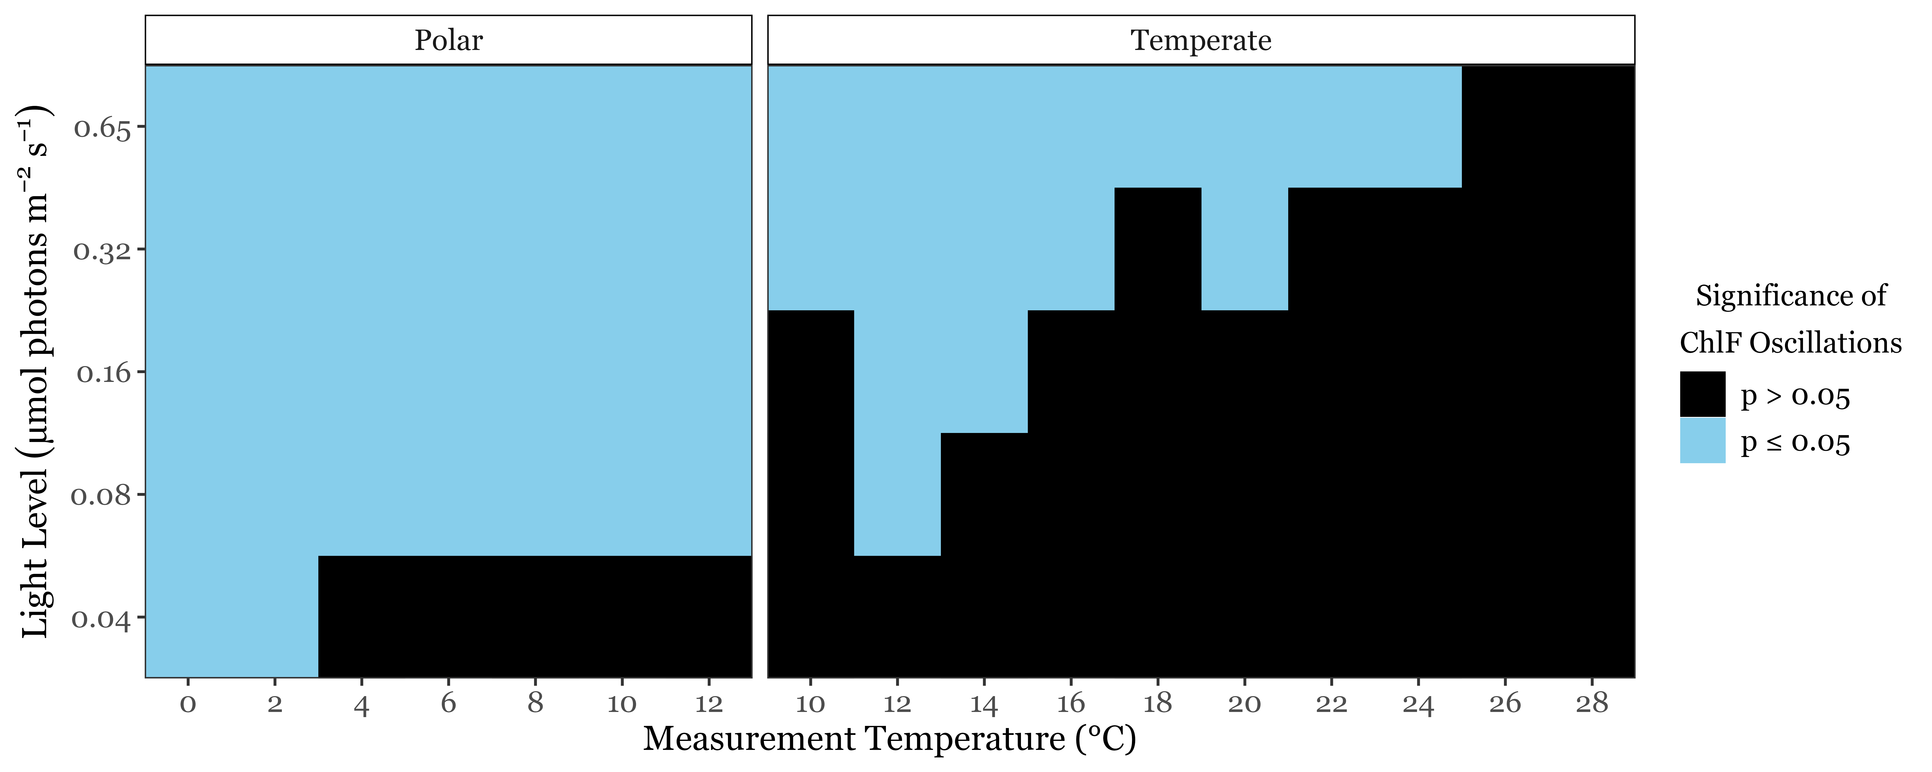
Polar strains exhibited synchronous cycling under a broader range of conditions

Slide 22
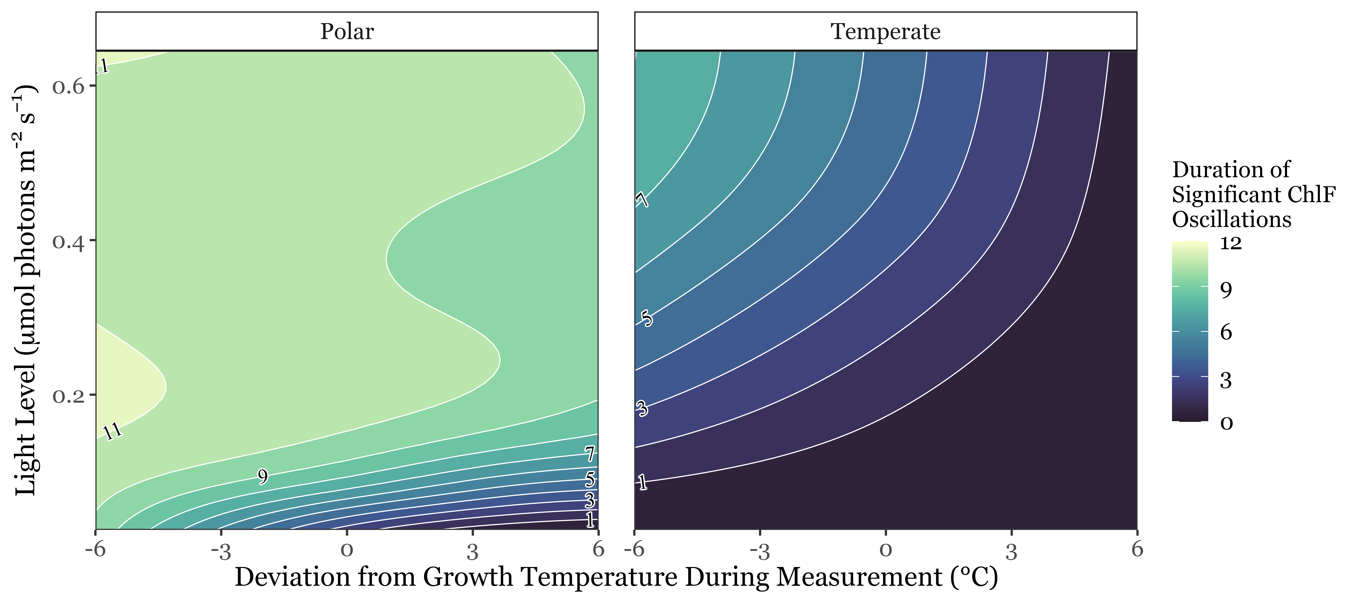
Polar strains sustained longer cycling under low light & comparable temperatures

Slide 23
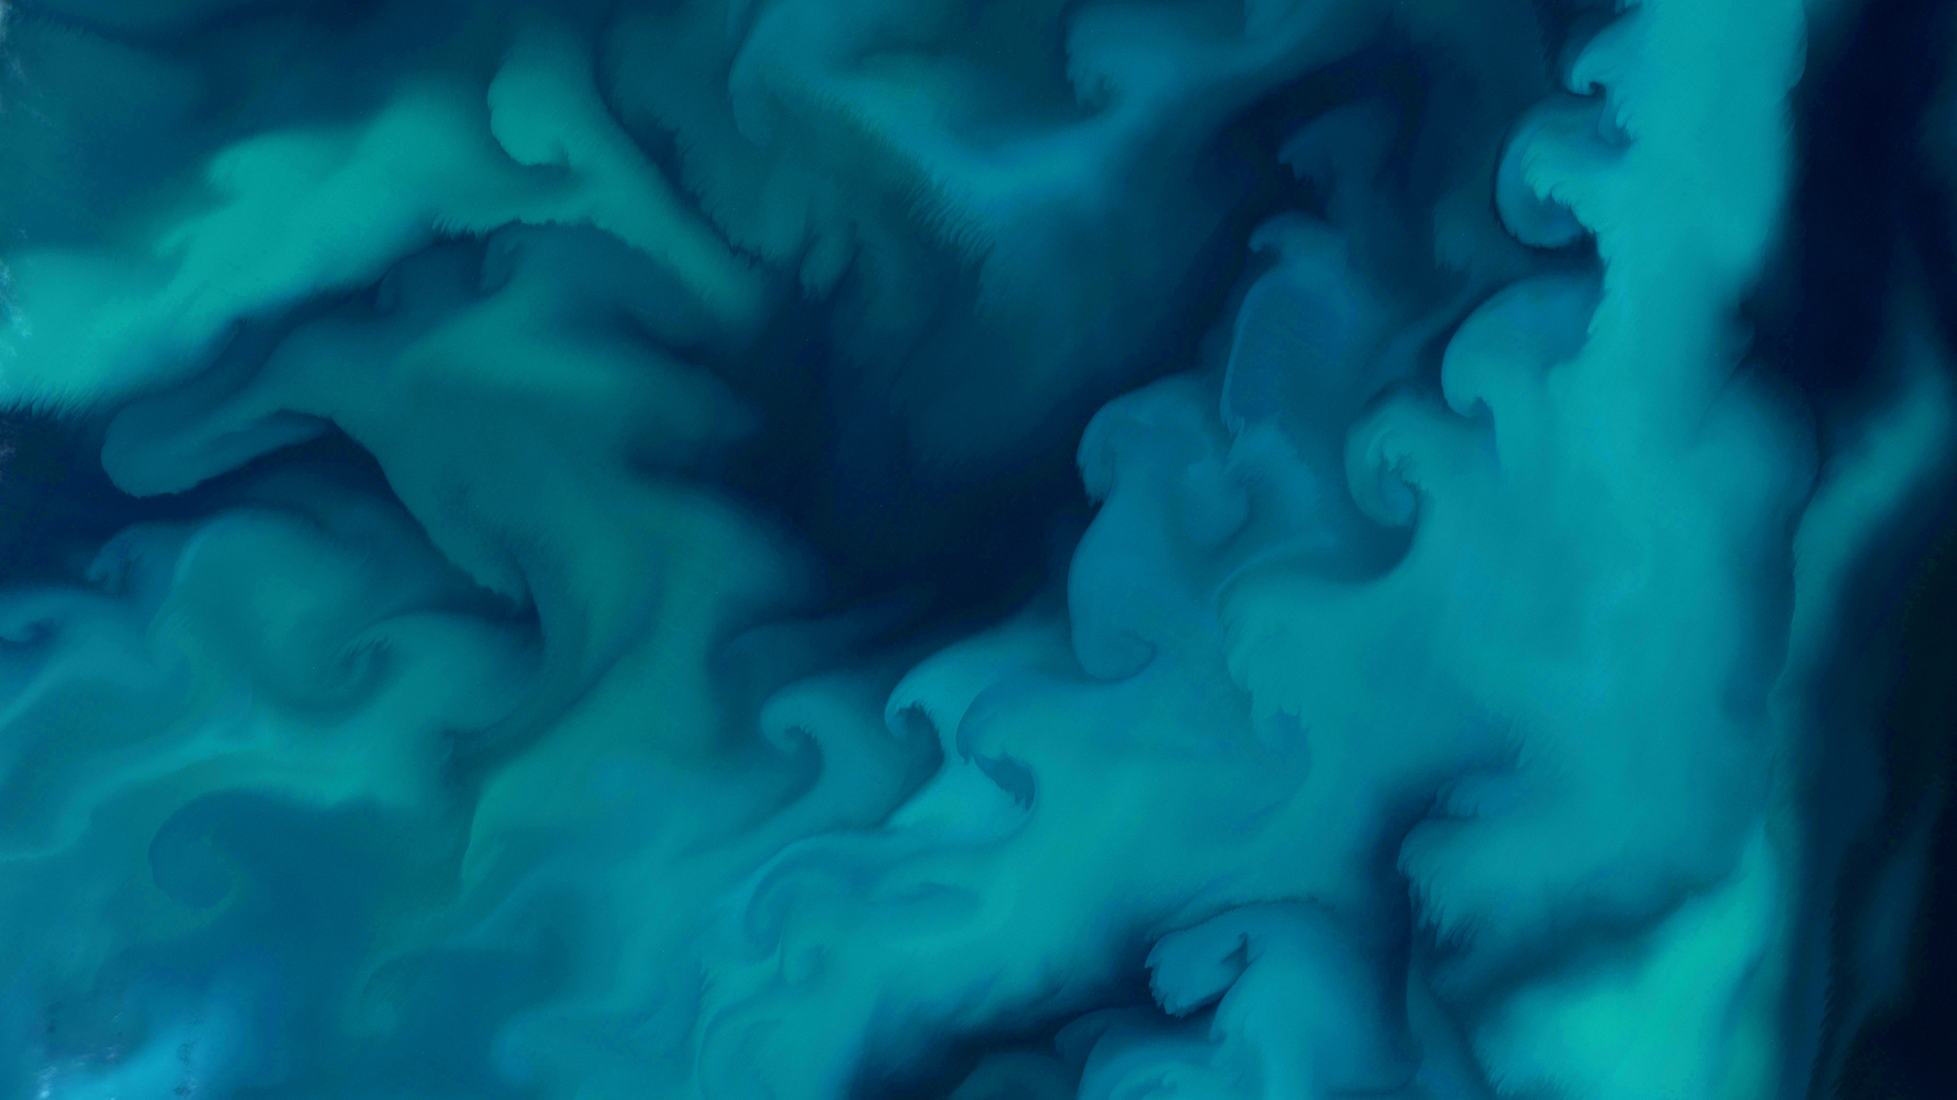
Polar phytoplankton exhibit the capacity to suppress energetically wasteful charge recombinations & sustain energetically efficient photosynthesis under extremely low light
1
Within strains, longer cycling was observed at higher light levels and colder temperatures
2
Polar strains exhibit significant cycling across a broader range of conditions than temperate strains
3
Under low light & comparable temperatures, polar strains sustain longer synchronous cycling than temperate strains
Phytoplankton Bloom extending over 500 000 km² in the Barents Sea, 2022. Copernicus

Slide 24
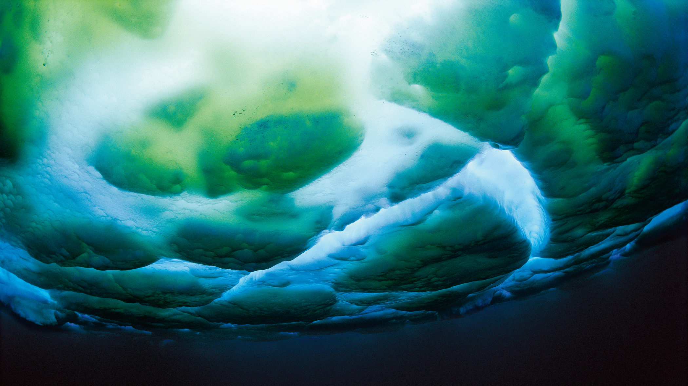





Acknowledgements
I thank my supervisor:
Dr. Douglas A. Campbell
as well as Campbell Lab members:
Dr. Maximilian Berthold, Dr. Sylwia Sliwinska-Wilczewska, Naaman Omar,
Mireille Savoie, & Miranda Corkum
and our partners at
The International Research Laboratory Takuvik at Université de Laval
& Cvetkovska Lab at the University of Ottawa

Slide 25
Questions?
Image: Maria Stenzel

Slide 26
References
Ardyna, M., & Arrigo, K. R. (2020). Phytoplankton dynamics in a changing Arctic Ocean. Nature Climate Change, 10(10), Article 10.
Berge, J., Renaud, P. E., Darnis, G., Cottier, F., Last, K., Gabrielsen, T. M., Johnsen, G., Seuthe, L., Weslawski, J. M., Leu, E., Moline, M., Nahrgang, J., Søreide, J. E., Varpe, Ø., Lønne, O. J., Daase, M., & Falk-Petersen, S. (2015). In the dark: A review of ecosystem processes during the Arctic polar night. Progress in Oceanography, 139, 258–271.
Berman-Frank, I., Campbell, D., Ciotti, A., Erickson, Z., Fujiki, T., Halsey, K., Hickman, A., Gorbunov, M., Hughes, D., Kolber, Z., Moore, M., Oxborough, K., Prasil, O., Robinson, C., Ryan-Keogh, T., Silsbe, G., Simis, S., Thomalla, S., & Varkey, D. (2023). Application of Single Turnover Active Chlorophyll Fluorescence for Phytoplankton Productivity Measurements. Version 2.0 [Report]. Scientific Committee on Oceanic Research (SCOR) Working Group 156.
Gates, C., Ananyev, G., & Dismukes, G. C. (2020). Realtime kinetics of the light driven steps of photosynthetic water oxidation in living organisms by “stroboscopic” fluorometry. Biochimica et Biophysica Acta (BBA) - Bioenergetics, 1861(8), 148212.
Hancke, K., Lund-Hansen, L. C., Lamare, M. L., Højlund Pedersen, S., King, M. D., Andersen, P., & Sorrell, B. K. (2018). Extreme Low Light Requirement for Algae Growth Underneath Sea Ice: A Case Study From Station Nord, NE Greenland. Journal of Geophysical Research: Oceans, 123(2), 985–1000.
Kawakami, K., & Shen, J.-R. (2018). Purification of fully active and crystallizable photosystem II from thermophilic cyanobacteria. In Methods in Enzymology (Vol. 613, pp. 1–16). Elsevier.
Keren, N., Berg, A., van Kan, P. J. M., Levanon, H., & Ohad, I. (1997). Mechanism of photosystem II photoinactivation and D1 protein degradation at low light: The role of back electron flow. Proceedings of the National Academy of Sciences, 94(4), 1579–1584.
Kirk, J. T. O. (2011). Light and Photosynthesis in Aquatic Ecosystems (3rd ed.). Cambridge University Press.
Mukhopadhyay, S., Mandal, S. K., Bhaduri, S., & Armstrong, W. H. (2004). Manganese Clusters with Relevance to Photosystem II. Chemical Reviews, 104(9), 3981–4026.
Randelhoff, A., Lacour, L., Marec, C., Leymarie, E., Lagunas, J., Xing, X., Darnis, G., Penkerc’h, C., Sampei, M., Fortier, L., D’Ortenzio, F., Claustre, H., & Babin, M. (2020). Arctic mid-winter phytoplankton growth revealed by autonomous profilers. Science Advances, 6(39), eabc2678.
Rappaport, F., Cuni, A., Xiong, L., Sayre, R., & Lavergne, J. (2005). Charge Recombination and Thermoluminescence in Photosystem II. Biophysical Journal, 88(3), 1948–1958.
Raven, J. A., Kübler, J. E., & Beardall, J. (2000). Put out the light, and then put out the light. Journal of the Marine Biological Association of the United Kingdom, 80(1), 1–25.
Roesch, A., & Schmidbauer, H. (2018). WaveletComp: Computational wavelet analysis [Manual].
Schuback, N., Tortell, P. D., Berman-Frank, I., Campbell, D. A., Ciotti, A., Courtecuisse, E., Erickson, Z. K., Fujiki, T., Halsey, K., Hickman, A. E., Huot, Y., Gorbunov, M. Y., Hughes, D. J., Kolber, Z. S., Moore, C. M., Oxborough, K., Prášil, O., Robinson, C. M., Ryan-Keogh, T. J., … Varkey, D. R. (2021). Single-Turnover Variable Chlorophyll Fluorescence as a Tool for Assessing Phytoplankton Photosynthesis and Primary Productivity: Opportunities, Caveats and Recommendations. Frontiers in Marine Science, 8.
Theis, F. J., & Meyer-Bäse, A. (2010). Spectral Transformations. In Biomedical Signal Analysis: Contemporary Methods and Applications (1st ed., p. 42). MIT Press.
Vass, I. (2011). Role of charge recombination processes in photodamage and photoprotection of the photosystem II complex. Physiologia Plantarum, 142(1), 6–16.
Zaharieva, I., & Dau, H. (2019). Energetics and Kinetics of S-State Transitions Monitored by Delayed Chlorophyll Fluorescence. Frontiers in Plant Science, 10.

